Slide 1
Welcome to BUSM 180 Introduction to Business
February 27, 2023

Slide 2
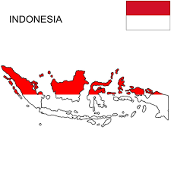
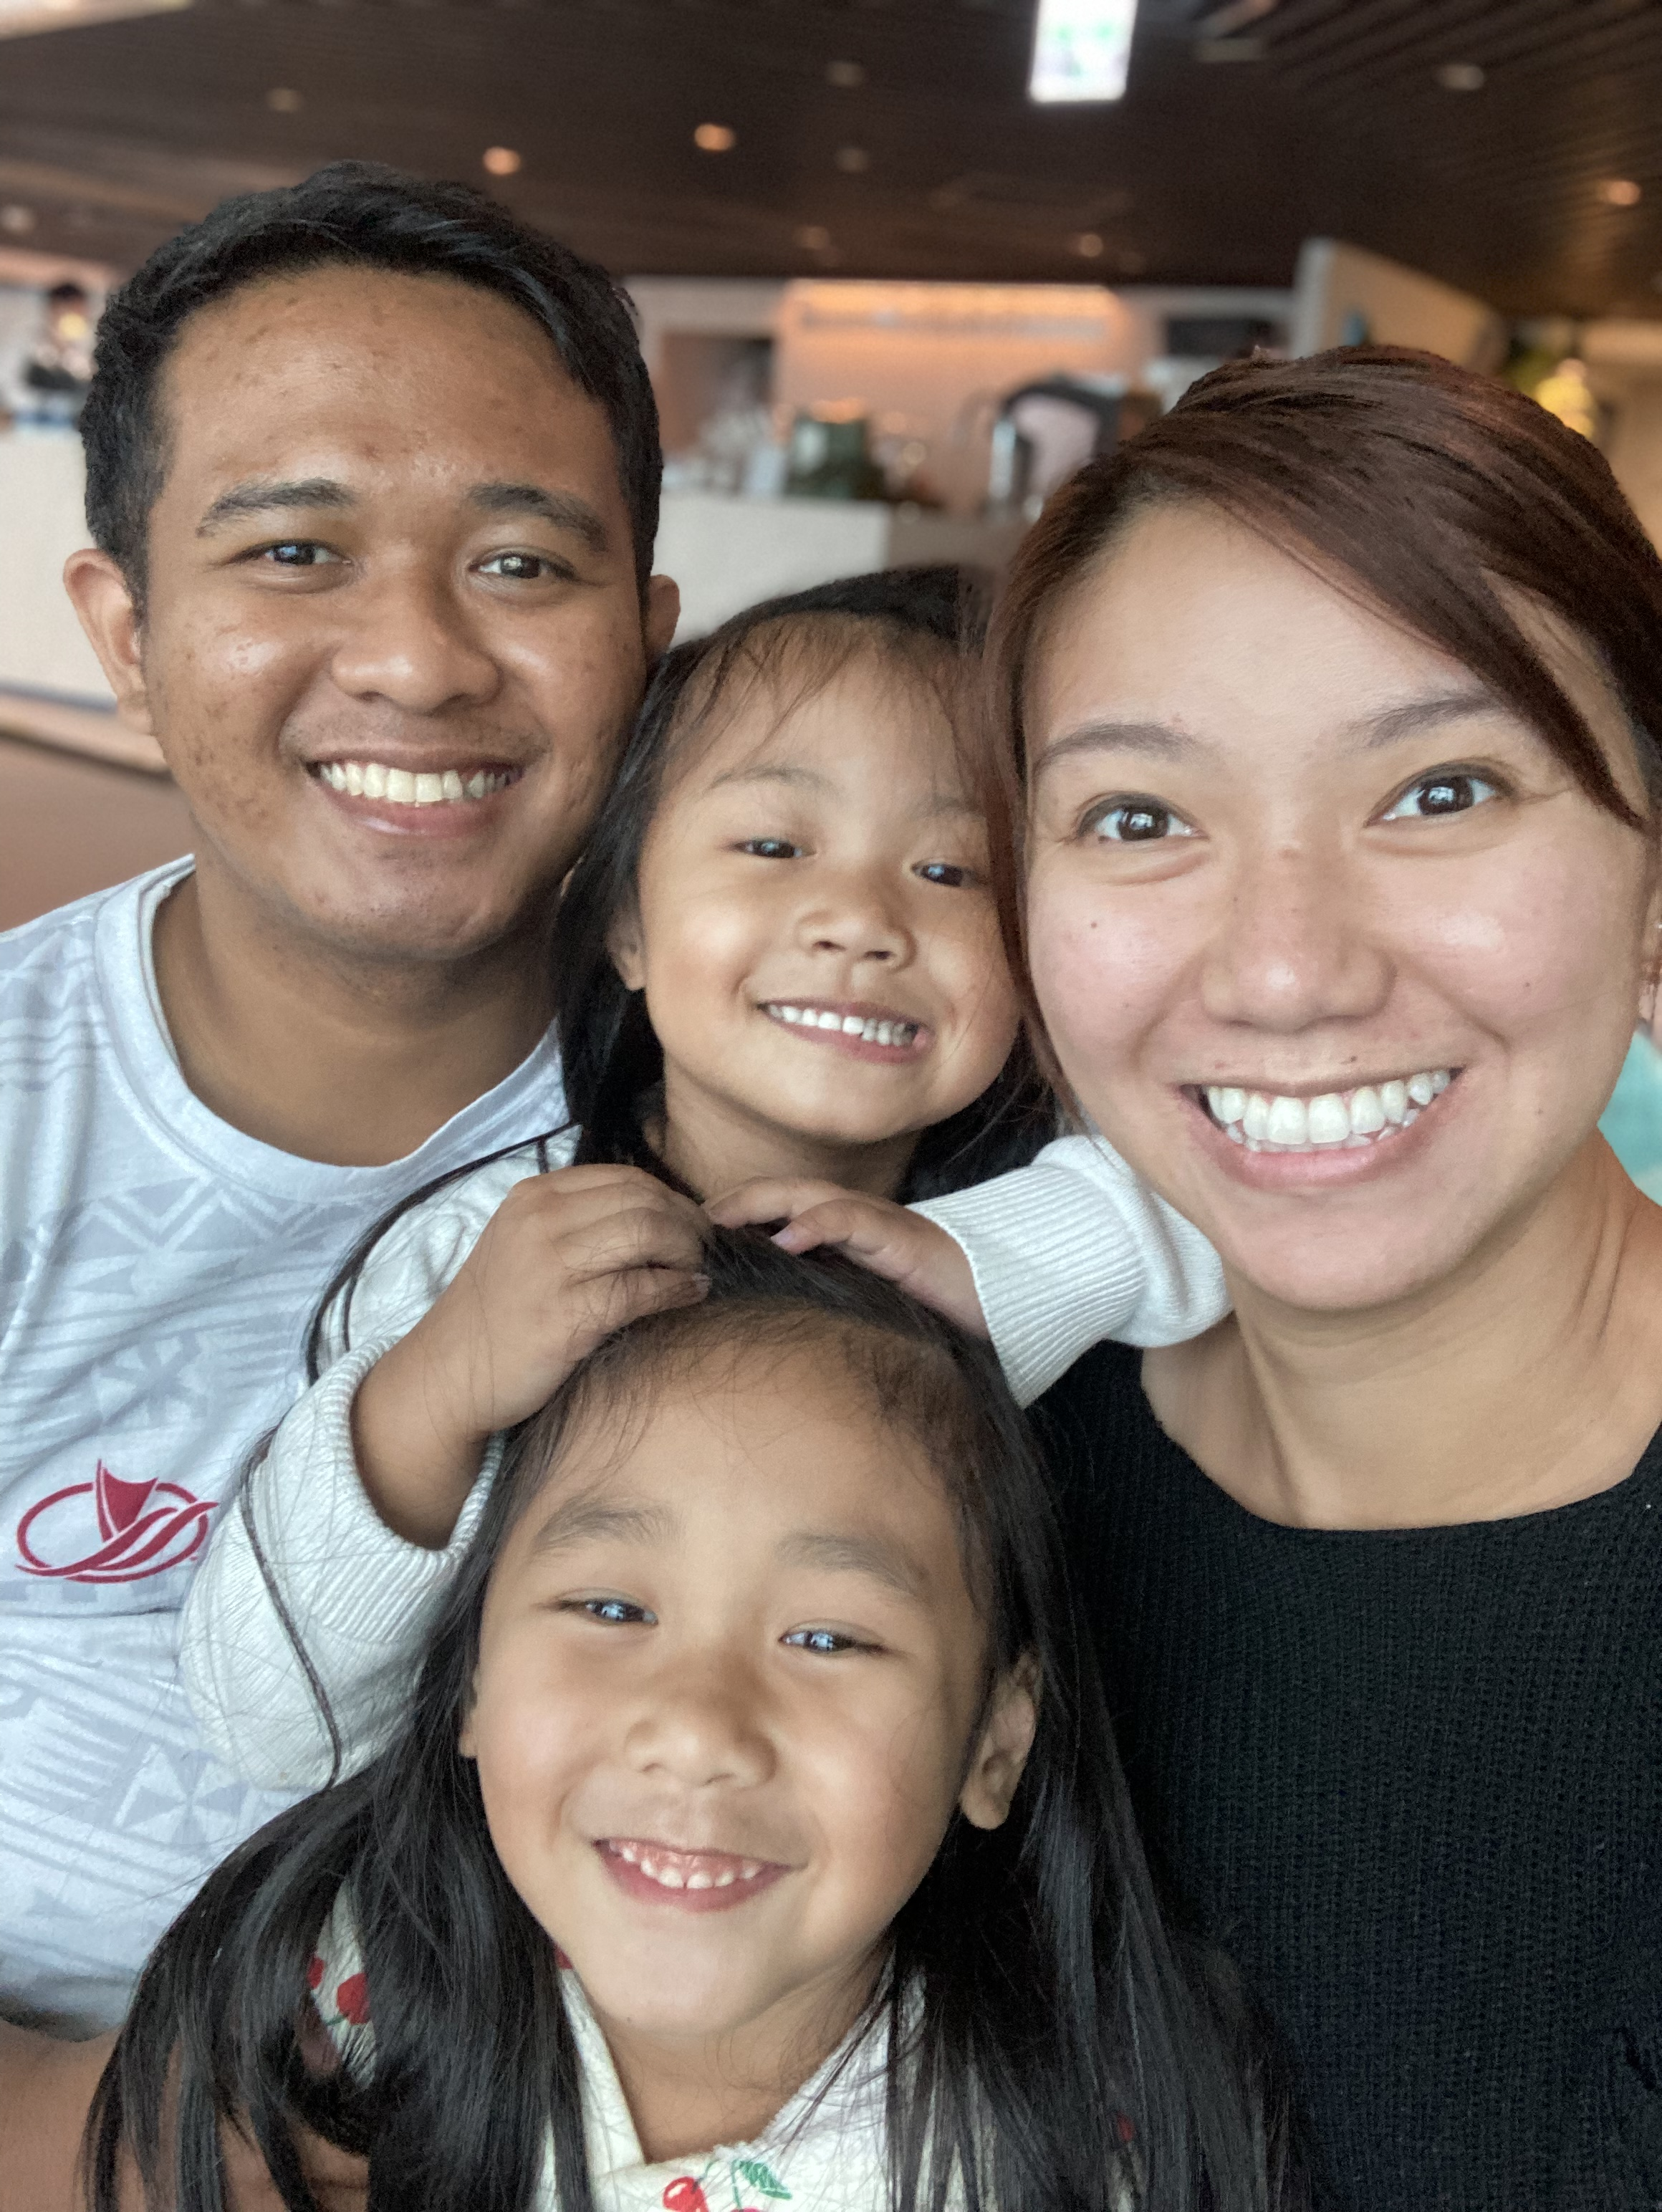
Today’s Instructor
Basic:
Name: Kevin Kusuma
Call Me: Brother Kusuma
Education:
Bachelor in Business & Hospitality from BYU-H
Master in Business Analytics from University of Utah
Teaching Experience:
Adjunct Faculty at BYU-H
BUSM 410 (Advanced Analytics & Big Data)
BUSM 461 (Quality Control & Process Improvement)

Slide 3
Introduce Yourself
What is your name?
Where are you from?

Slide 4

Let’s Do A Quick Exercise
https://create.kahoot.it/details/12b747eb-4371-436c-ae50-256504afd3ca

Slide 5
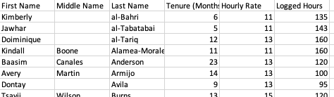
In-class Activity
Feelin' Brisket is a small restaurant in Dallas, Texas. Felicia recently bought the restaurant which employs several workers including cooks, servers, and bussers. She received the employee list which includes their hourly rate and their logged hours of the previous month. Could you please help Felicia analyze her new restaurant by answering these questions:
How many employees does the restaurant have?
What is the average tenure of the employees?
What is the average hourly rate of all employees?
What are the total logged hours?
What is the total labor cost?

Slide 6
github.com/c-kevin-Kusuma/byuh

Slide 7
Next Class
To-do List:
Fresh Sushi Excel (Due before next class)
Email me for questions at mulyono@go.byuh.edu
Add me on LinkedId at linkedin.com/in/ckkusuma/

